Slide 1



Expert Banking System for Fraud Detection and Loan
Approval Analysis
Presented by:
Ali Mohamed Ali Hashish
Mostafa Ossama Abdelzaher
Omar Mohamed Ahmed Amin
Presented to:
Dr. Lydia Wahid

Slide 2
Agenda
Introduction
Motivation
Proposed Approach
Evaluation Metrics
Results
Summary & Key Findings
Conclusion & Future Work

Slide 3
Introduction
Fraud Detection and Loan Approval are two major problems in the financial sector.
Fraud detection involves recognizing unusual or suspicious behavior that may suggest an ongoing attempt to steal money, data, or other valuable resources.
Loan approval systems are digital tools, either fully or partially automated, that help financial institutions assess applicants and determine if they qualify for a loan.

Slide 4
Motivation
Need for efficient and accurate banking services calls for intelligent systems to automate critical operations like Fraud Detection and Loan Approvals.
Machine Learning models use significant computational power and environmental cost (e.g., GPU/cloud usage), expert systems are lightweight and more sustainable.
Traditional rule-based expert systems are undervalued nowadays where everyone is trying to integrate more complicated Machine Learning models.

Slide 5

Our Research

Slide 6
Proposed Approach
Acquiring and preprocessing both the loan approval analysis and fraud detection datasets.
Building a rule based expert system using ID3 algorithm to generate the rules.
Comparing the results with other machine learning approaches such as SVM and logistic regression.
Inference using Experta, a Python expert system library.

Slide 7
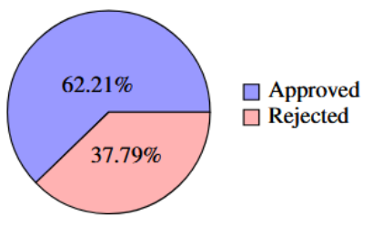
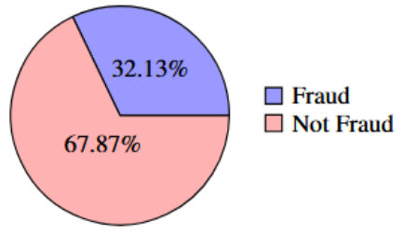
Proposed Approach - Dataset - Target Class Distribution
Loan Approval (4,269 records)
Fraud Detection (50,000 records)

Slide 8
Proposed Approach - Dataset - Important Features
Loan Approval
Annual income
Education level
Employment status
Loan amount
Loan term
Credit score
Asset values
Fraud Detection
Transaction amount
Transaction type
Account balance
Statistics for card usage frequency
Risk score
Transaction timestamp
Card type

Slide 9
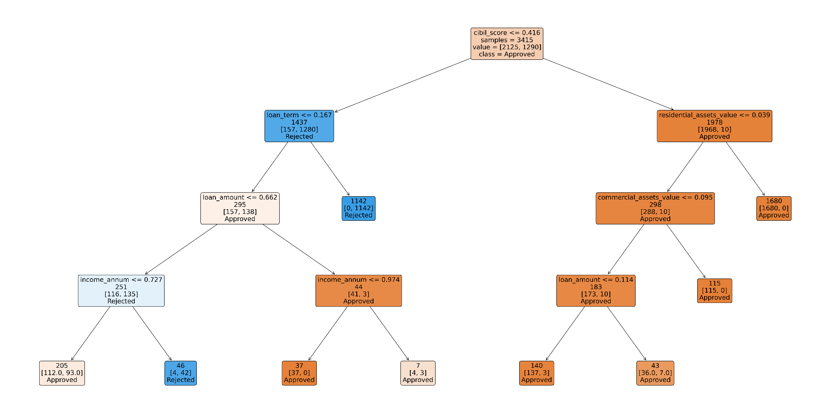
Proposed Approach - Rules - Loan Approval

Slide 10
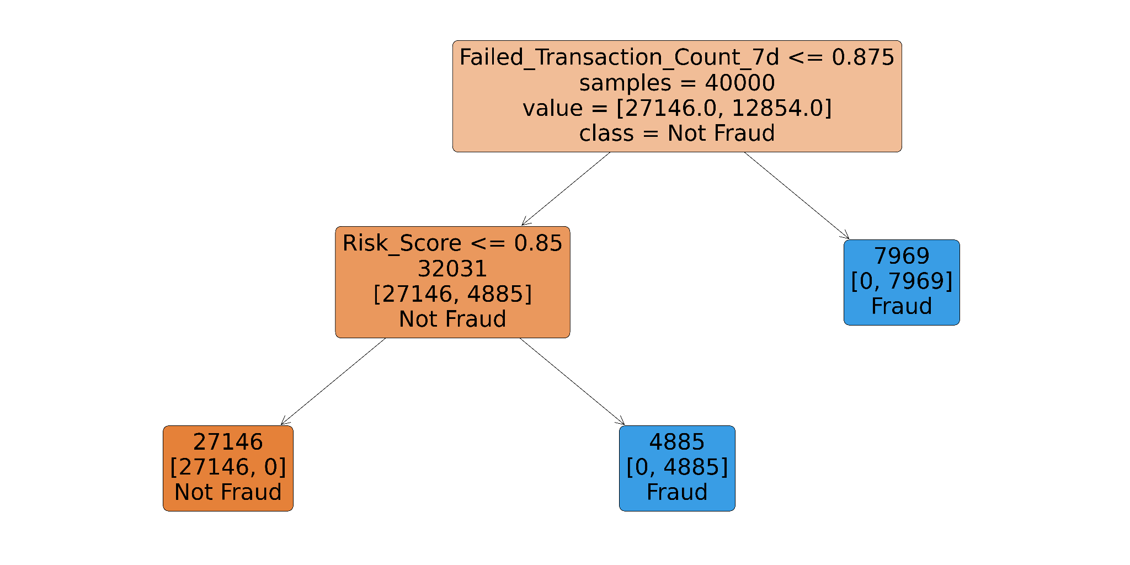
Proposed Approach - Rules - Fraud

Slide 11
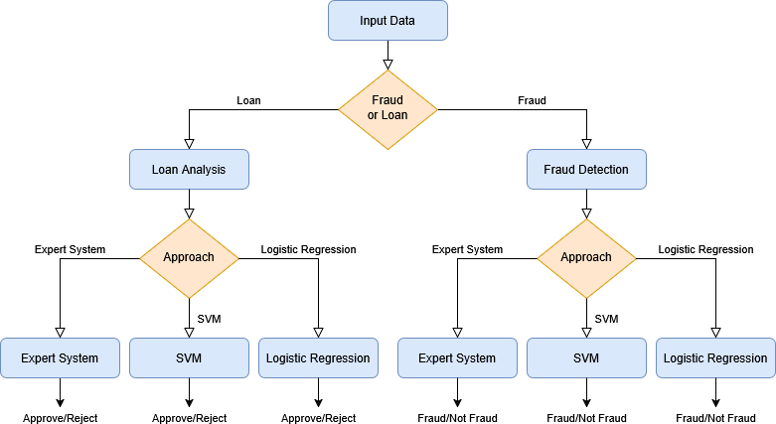
Proposed Approach - Overall Pipeline

Slide 12
Evaluation Metrics
Accuracy: Overall correctness of the model.
Precision: Correct positive predictions / total positive predictions.
Recall: Correct positive predictions / total actual positives.
F1-score: Harmonic mean of precision and recall.
Metrics chosen for balanced evaluation of performance.

Slide 13
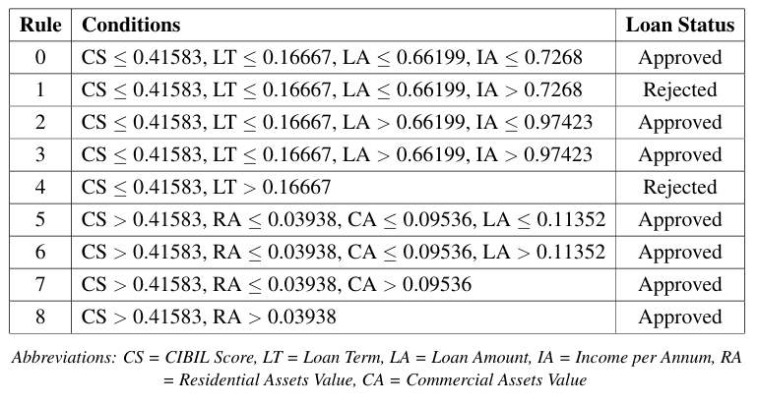
Results - Loan Analysis Rules

Slide 14
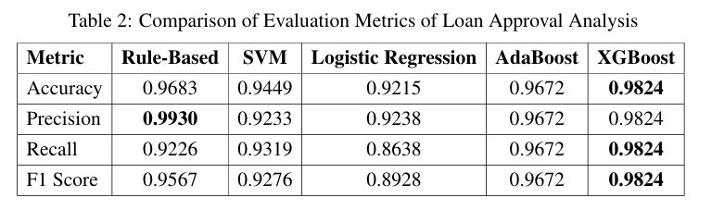
Results - Loan Analysis Results

Slide 15
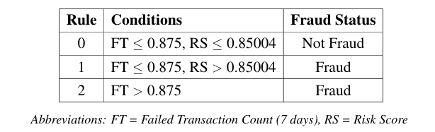
Results - Fraud Analysis Rules

Slide 16
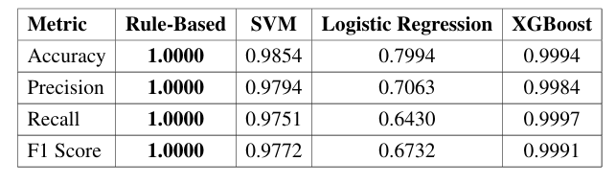
Results - Fraud Analysis Results

Slide 17
Results - Discussion
Loan Analysis
Expert System: 96.83% accuracy, 99.3% precision.
Slightly outperformed by XGBoost, but ahead of SVM and LR.
Fraud Detection
Expert System achieved a perfect score.
Outperformed all ML models tested.
Expert systems demonstrate competitive or superior performance.

Slide 18
Summary & Key Findings
Expert systems remain relevant and effective.
Provide interpretable and efficient decision rules.
Outperform traditional ML in fraud detection, yet there is the risk of overfitting.
Comparable results in loan approval analysis.

Slide 19
Conclusion
Expert systems can complement or even replace ML in certain banking applications.
Expert systems can be valuable when computational cost or interpretability is a concern.

Slide 20
Future work
Demonstrate that expert systems can effectively address diverse and evolving needs in the banking and financial sector, other than Fraud Detection and Loan Approval.
Extend the system to support a broader range of decision-making tasks in banking and financial sector.
Develop rule-based models to predict customer actions, such as likelihood to respond to marketing campaigns.
Identify customers more likely to purchase or subscribe to financial services.

Slide 21

Thank You

